Slide 1
Regression Analysis
Model Selection
Nicoleta Serban, Ph.D.
Professor
Stewart School of Industrial and Systems Engineering
Model Search: Data Examples

Slide 2

About This Lesson

Slide 3
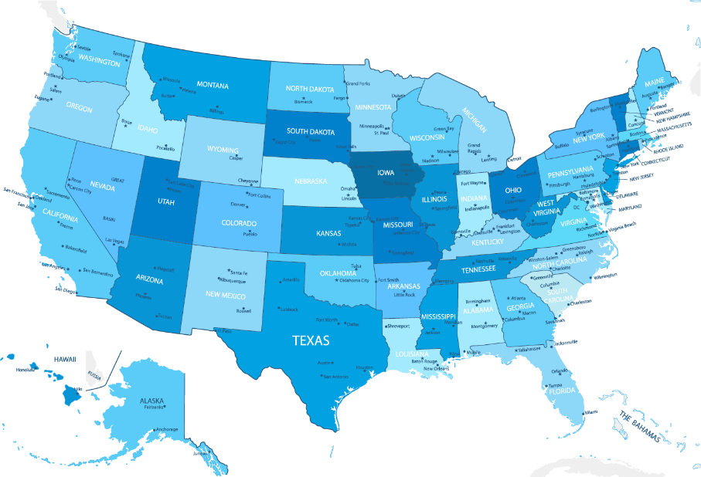
Ranking States by SAT Performance
Which variables are associated with state average SAT scores?
After accounting for selection biases, how do the states rank?
Which states perform best for the amount of money they spend?
SAT Mean Score by State – Year 1982
790 (South Carolina) – 1088 (Iowa)

Slide 4
Compare All Models
library(leaps)
out = leaps(datasat[,-c(1,2)], sat, method = "Cp")
cbind(as.matrix(out$which),out$Cp)
1 2 3 4 5 6
1 0 0 0 0 0 1 34.026834
1 1 0 0 0 0 0 47.639512
1 0 1 0 0 0 0 187.387572
1 0 0 1 0 0 0 269.647903
1 0 0 0 1 0 0 306.188562
1 0 0 0 0 1 0 307.076043
⋮
6 1 1 1 1 1 1 7.000000
best.model = which(out$Cp==min(out$Cp))
cbind(as.matrix(out$which), out$Cp)[best.model,]
1 2 3 4 5 6
0.000000 0.000000 1.000000 1.000000 1.000000 1.000000 3.581157
The output includes all 64 combinations of predictors with specification of which predictors are in the model and the Cp score value for each model.
The best model with respect to Mallow’s Cp criterion:
years, public, expend, rank (last four predictors in the input dataset)
Does not allow for specification of controlling variables!!!

Slide 5
Stepwise Regression
# Forward Stepwise Regression
step(lm(sat~log(takers)+rank), scope=list(lower=sat~log(takers)+rank,
upper=sat~log(takers)+rank+expend+years+income+public), direction="forward")
Start: AIC=346.7
sat ~ log(takers) + rank
Step: AIC=331.66
sat ~ log(takers) + rank + expend
Step: AIC=323.9
sat ~ log(takers) + rank + expend + years
Call:
lm(formula = sat ~ log(takers) + rank + expend + years)
Coefficients:
(Intercept) log(takers) rank expend years
388.425 -38.015 4.004 2.423 17.857
 | Df | Sum of Sq | RSS | AIC
+ expend | 1 | 13149.5 | 32380 | 331.66
+ years | 1 | 9827.2 | 35703 | 336.55
<none> |  |  | 45530 | 346.70
+ income | 1 | 1305.3 | 44224 | 347.25
+ public | 1 | 15.9 | 45514 | 348.69
 | Df | Sum of Sq | RSS | AIC
<none> |  |  | 26637 | 323.90
+ income | 1 | 26.6165 | 26610 | 325.85
+ public | 1 | 4.5743 | 26632 | 325.89
 | Df | Sum of Sq | RSS | AIC
+ years | 1 | 5743.5 | 26637 | 323.90
<none> |  |  | 32380 | 331.66
+ public | 1 | 421.0 | 31959 | 333.01
+ income | 1 | 317.3 | 32063 | 333.17
Selected model: expend and years, with confounding variables log(takers) and rank

Slide 6
Stepwise Regression (cont’d)
# Backward Stepwise Regression
full = lm(sat ~ log(takers) + rank + expend + years + income + public)
minimum = lm(sat ~ log(takers) + rank)
step(full, scope=list(lower=minimum, upper=full), direction="backward")
Start: AIC=327.8
sat ~ log(takers) + rank + expend + years + income + public
Step: AIC=325.85
sat ~ log(takers) + rank + expend + years + income
 | Df | Sum of Sq | RSS | AIC
- public | 1 | 25.0 | 26610 | 325.85
- income | 1 | 47.0 | 26632 | 325.89
<none> |  |  | 26585 | 327.80
- years | 1 | 4588.8 | 31174 | 333.77
- expend | 1 | 6264.4 | 32850 | 336.38
Step: AIC=323.9
sat ~ log(takers) + rank + expend + years
Call:
lm(formula = sat ~ log(takers) + rank + expend + years)
Coefficients:
(Intercept) log(takers) rank expend years
388.425 -38.015 4.004 2.423 17.857
 | Df | Sum of Sq | RSS | AIC
<none> |  |  | 26637 | 323.90
- years | 1 | 5743.5 | 32380 | 331.66
- expend | 1 | 9065.8 | 35703 | 336.55
 | Df | Sum of Sq | RSS | AIC
- income | 1 | 26.6 | 26637 | 323.90
<none> |  |  | 26610 | 325.85
- years | 1 | 5452.8 | 32063 | 333.17
- expend | 1 | 7430.3 | 34040 | 336.16

Slide 7
Stepwise Regression (cont’d)
# Backward Stepwise Regression
full = lm(sat ~ log(takers) + rank + expend + years + income + public)
minimum = lm(sat ~ log(takers) + rank)
step(full, scope=list(lower=minimum, upper=full), direction="backward")
Selected model includes
  expend and years
  confounding variables log(takers) and rank
The same model was selected using forward regression
  Generally, for a large number of predictors, the two methods will select different models
Start: AIC=327.8
sat ~ log(takers) + rank + expend + years + income + public
Step: AIC=325.85
sat ~ log(takers) + rank + expend + years + income
 | Df | Sum of Sq | RSS | AIC
- public | 1 | 25.0 | 26610 | 325.85
- income | 1 | 47.0 | 26632 | 325.89
<none> |  |  | 26585 | 327.80
- years | 1 | 4588.8 | 31174 | 333.77
- expend | 1 | 6264.4 | 32850 | 336.38
Step: AIC=323.9
sat ~ log(takers) + rank + expend + years
Call:
lm(formula = sat ~ log(takers) + rank + expend + years)
Coefficients:
(Intercept) log(takers) rank expend years
388.425 -38.015 4.004 2.423 17.857
 | Df | Sum of Sq | RSS | AIC
<none> |  |  | 26637 | 323.90
- years | 1 | 5743.5 | 32380 | 331.66
- expend | 1 | 9065.8 | 35703 | 336.55
 | Df | Sum of Sq | RSS | AIC
- income | 1 | 26.6 | 26637 | 323.90
<none> |  |  | 26610 | 325.85
- years | 1 | 5452.8 | 32063 | 333.17
- expend | 1 | 7430.3 | 34040 | 336.16

Slide 8
Predicting Bankruptcy
Effective bankruptcy prediction is useful for investors and analysts, allowing for accurate evaluation of a firm’s prospects.
Roughly 40 years ago, Ed Altman showed that publicly available financial indicators can be used to distinguish between firms that are about to go bankrupt and those that are not.
Which financial indicators are associated with bankruptcy for telecommunications firms?
Acknowledgement: This example was provided by Dr. Jeffrey Simonoff from New York University and was inspired by the honors thesis of Jeffrey Lui.

Slide 9
Compare All Models
library(bestglm)
input.Xy <- as.data.frame(cbind(WC.TA, RE.TA, EBIT.TA, S.TA, BVE.BVL,Bankrupt))
bestBIC <- bestglm(input.Xy, IC=“BIC“, family=binomial)
bank2 = glm(Bankrupt~RE.TA+EBIT.TA+BVE.BVL, family=binomial, epsilon=1e-14, maxit=500, x=T)
summary(bank2)
Coefficients:
The best model selected with respect to BIC:
RE.TA, EBIT.TA, BVE.BVL
RE.TA is now statistically significant at α = 0.05
Not all coefficients are statistically significant
 | Estimate | Std. Error | z value | Pr(>|z|)
(Intercept) | -0.29478 | 1.12323 | -0.262 | 0.7930
RE.TA | -0.05627 | 0.02745 | -2.050 | 0.0404 *
EBIT.TA | -0.16763 | 0.09270 | -1.808 | 0.0706 .
BVE.BVL | -0.62975 | 0.39435 | -1.597 | 0.1103
RE.TA is associated with a decrease in the odds of going bankrupt in the next year by 5.5% holding all else fixed
EBIT.TA is associated with a decrease in the odds of going bankrupt by 15%

Slide 10
Compare All Models (cont’d)
# Testing for subset of regression coefficients
gstat = deviance(bank2) - deviance(bank1)
cbind(gstat, 1-pchisq(gstat,length(coef(bank1))-length(coef(bank2))))
gstat
[1,] 4.040336 0.1326332
The null (reduced model) is not rejected

Slide 11
Remove Outlier
bankrupt2 = bankruptcy[-1,]
attach(bankrupt2)
bank3 = glm(Bankrupt ~ WC.TA + RE.TA + EBIT.TA + S.TA + BVE.BVL, family=binomial,
maxit=500, data=bankrupt2)
Warning message:
glm.fit: fitted probabilities numerically 0 or 1 occurred
summary(bank3)
Coefficients:
The model fits perfectly. This is complete separation, and the solution is to simplify the model if that is possible.
 | Estimate | Std. Error | z value | Pr(>|z|)
(Intercept) | 265.467 | 576281.709 | 0 | 1
WC.TA | -4.297 | 12439.717 | 0 | 1
RE.TA | -1.516 | 5131.146 | 0 | 1
EBIT.TA | -17.043 | 35543.170 | 0 | 1
S.TA | -2.859 | 7408.747 | 0 | 1
BVE.BVL | -77.540 | 184903.001 | 0 | 1

Slide 12
Compare All Models: Without Outlier
input.Xy <- as.data.frame(cbind(WC.TA, RE.TA, EBIT.TA, S.TA, BVE.BVL,Bankrupt))
bestBIC <- bestglm(input.Xy, IC=“BIC“, family=binomial)
bank4 = glm(Bankrupt ~ RE.TA + EBIT.TA + BVE.BVL, family=binomial, maxit=500)
summary(bank4)
Coefficients:
exp(coef(bank2)[-1])
RE.TA EBIT.TA BVE.BVL
0.9452862 0.8456655 0.5327273
exp(coef(bank4)[-1])
RE.TA EBIT.TA BVE.BVL
0.9210091 0.7650371 0.2957930
The best model selected with respect to BIC:
WC.TA, RE.TA, EBIT.TA, BVE.BVL
 | Estimate | Std. Error | z value | Pr(>|z|)
(Intercept) | -0.09166 | 1.47135 | -0.062 | 0.9503
RE.TA | -0.08229 | 0.04230 | -1.945 | 0.0517 .
EBIT.TA | -0.26783 | 0.15854 | -1.689 | 0.0912 .
BVE.BVL | -1.21810 | 0.76536 | -1.592 | 0.1115

Slide 13
Stepwise Regression: Without Outlier
bank3.select=step(bank3, direction="backward")
summary(bank3.select)
Start: AIC=12
Bankrupt ~ WC.TA + RE.TA + EBIT.TA + S.TA + BVE.BVL
Step: AIC=10
Bankrupt ~ WC.TA + RE.TA + EBIT.TA + BVE.BVL
 | Df | Deviance | AIC
- S.TA | 1 | 0.0000 | 10.000
<none> |  | 0.0000 | 12.000
- WC.TA | 1 | 9.3839 | 19.384
- RE.TA | 1 | 10.7362 | 20.736
- EBIT.TA | 1 | 14.7992 | 24.799
- BVE.BVL | 1 | 19.0267 | 29.027
 | Df | Deviance | AIC
<none> |  | 0.0000 | 10.000
- WC.TA | 1 | 9.3841 | 17.384
- RE.TA | 1 | 12.8531 | 20.853
- EBIT.TA | 1 | 14.8672 | 22.867
- BVE.BVL | 1 | 19.1321 | 27.132
Stepwise regression selects the same four predictors as the best subset selection approach using BIC.
Coefficients:
 | Estimate | Std. Error | z value | Pr(>|z|)
(Intercept) | 255.413 | 728539.823 | 0 | 1
WC.TA | -9.542 | 23920.936 | 0 | 1
RE.TA | -5.152 | 15669.825 | 0 | 1
EBIT.TA | -28.983 | 90578.211 | 0 | 1
BVE.BVL | -103.614 | 225264.760 | 0 | 1

Slide 14

Summary

